Slide 1

Why is 802.11b 11 Mbps?
Understanding Wireless Data Transmissions, or…
Stephen Lien
Technology Director
Redwood Area Schools
slien@redwoodareaschools.com

Slide 2


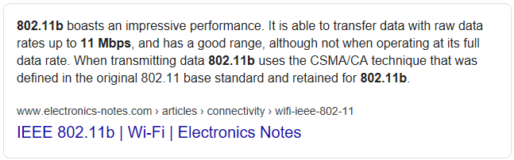

What’s this all about?
010011010
10Base-T: 10MHz x 1bpHz = 10Mbps
“OK Google, why is 802.11b 11Mbps?”
Not a wireless engineer
1Hz
1Hz
1Hz
1Hz
1Hz
1Hz
1Hz
1Hz

Slide 3

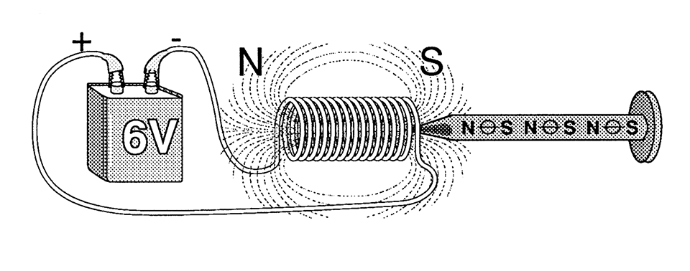
Electromagnetic Fields
Remember this?
Field of electromagnetic force from the motion of an electric charge
Forms orthogonal to electron flow
Electron flow
Magnetic Field
Magnetic Field

Slide 4
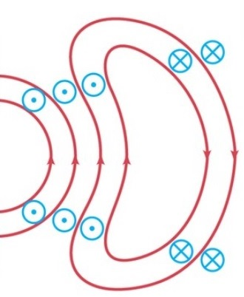



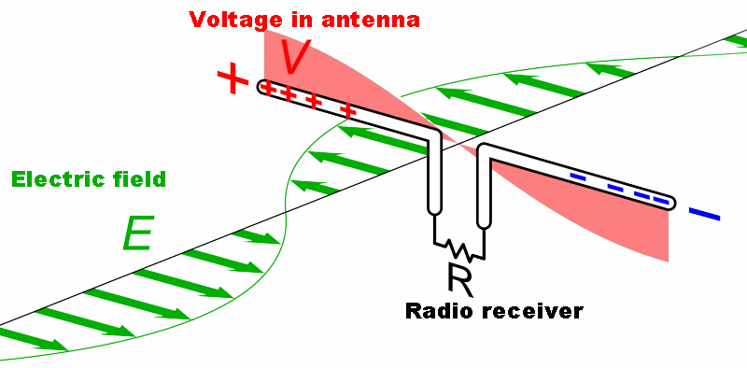
Radio Signals
Oscillating current in antenna = Radio Signal
Received signal induces current, reproduces sent signal
+
I
–
+
I
–

Slide 5
Encoding Data Onto a Signal
Modulation: varying waveform properties
Three ways to modulate signal
  Amplitude
  Frequency
  Phase
802.11b Modulation

Slide 6
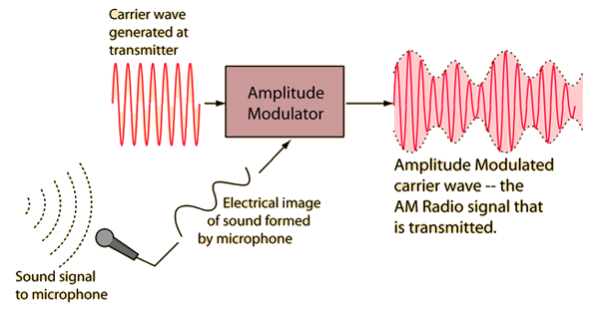
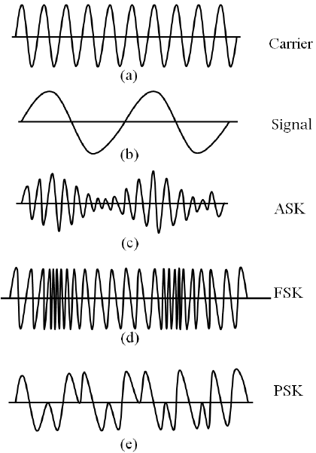
Fixing Misconceptions
Frequency = data rate
Frequency is “carrier wave”
Data encoded onto carrier wave
Data rate < frequency
Max. data rate a function of signal strength and line noise

Slide 7
Phase Shift Modulation
BPSK: binary phase shift keying
QPSK: quadrature phase shift keying
Did it shift?
Did it shift?
Did it shift?
Did it shift?
0
1
0
1
802.11b
Did it shift?
Did it shift?
Did it shift?
Did it shift?
dibit
How much?
How much?
How much?
00
01
11
10

Slide 8
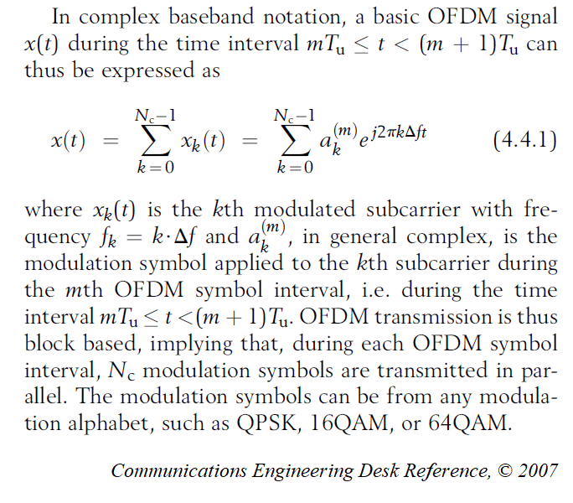

And Here Comes the Rabbit Hole!

Slide 9
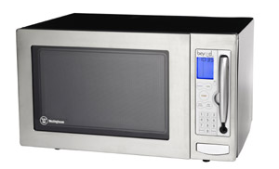
Handling Interference
NOISE
11MHz Channel
1MHz Sub-Channel @ 2.442 GHz

Slide 10

Direct Sequence Spread Spectrum
1Mbps Recipe:
  To transmit one bit:
    0: transmit 0 0 1 1 0 0 1 1 0 1 1
    1: transmit 1 1 0 0 1 1 0 0 1 0 0
    Symbol rate = 1 million Symbols / sec.
    1MSps x 1 bit/S = 1Mbps
2Mbps Recipe:
  Transmit dibits
    1MSps x 2 bits/S = 2Mbps
1
Barker Codes
1
11001100100
Symbol

Slide 11

DSSS, Continued
0010
5.5Mbps Recipe:
  To transmit four bits:
    Symbol size shrunk from 11 to 8 dibits
    Symbols overlap on channels
    4 bits data encoded (CCK) onto 8 dibits
    (11 ÷ 8) MSps x 4 bit/S = 5.5Mbps
11Mbps Recipe:
  To transmit eight bits:
    8 bits encoded onto 8 dibits
    1.375 MSps x 8 bits/S = 11Mbps
10101011
3/8
Next
Sym
10111010
0010

Slide 12
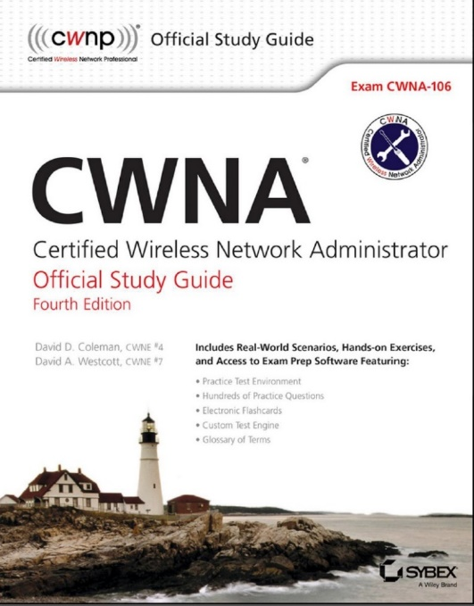

For Reference’s Sake…
Consult your local 1700 page CWNA study guide
Or your 568 page Communications Engineering Desk Reference manual

Slide 13
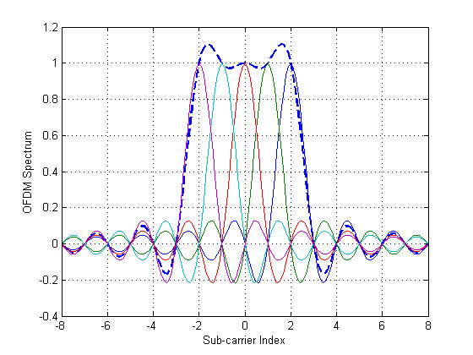
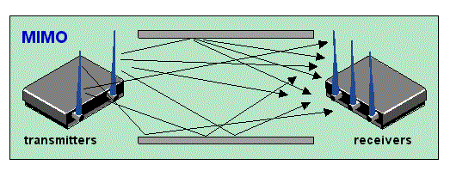
How Did Wi-Fi Get Faster?
Better modulation
  QPSK → 64-QAM
    2 bit values → 8 bit values
  Multiplexing (OFDM)
    Overlapping multiple signals on the same bandwidth
Multiple Antenna (MIMO)
Channel Bonding

Slide 14

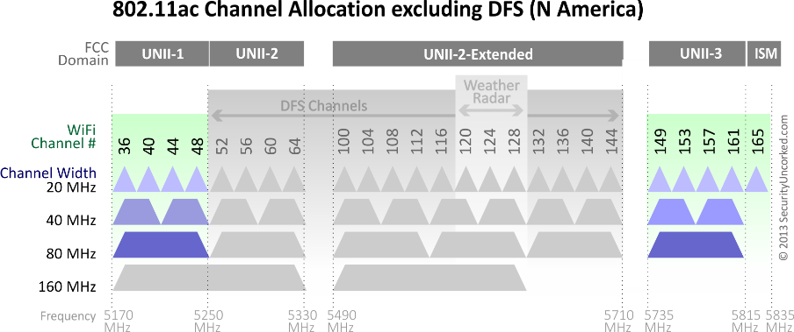
Where’s My Gigabit Wi-Fi?
Encoding reaching its limit
  Noise built into engineering
  More data = more loss
Higher frequencies?
  Signals don’t propagate
Channel Bonding on 5GHz
  9 20MHz Ch. @ 173Mbps
  4 40MHz Ch. @ 400Mbps
  2 80MHz Ch. @ 867Mbps

Slide 15

To Fix the Problem…
E

Slide 16

Wi-Fi 6e (802.11ax² ?)
FCC opening 5.9GHz – 7.1Ghz spectrum
AKA “6GHz spectrum”
Existing frequencies?
14 80GHz 1Gbps channels
7 160GHz 2Gbps channels
Nothing formalized

Slide 17

See Me w/ Questions
Very simplified information
Good to know what we’re dealing with
Please present @ Brainstorm!!!

